Slide 1
FIFA World Cup 2022 Zonaid All Maksud ID:213100013

Slide 2
Introduction
The 2022 FIFA World Cup was the 22nd FIFA World Cup, the quadrennial world championship for national Football teams organized by FIFA.
It took place in Qatar from 20 November to 18 December 2022, after the country was awarded the hosting rights in 2010.
It was the first World Cup to be held in the Middle East and Persian Gulf countries, and the second held entirely in Asia after the 2002 tournament in South Korea and Japan.
2

Slide 3
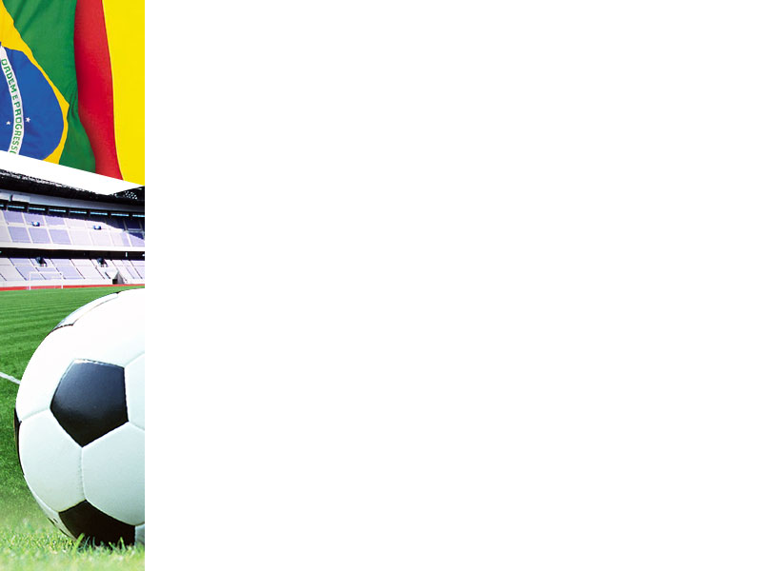
Format
The FIFA World Cup is a professional football tournament held between national football teams, organised by FIFA.
The event was scheduled to take place under a reduced length, from 20 November to 18 December in Qatar.
Being held in Qatar, it was the first World Cup tournament to be held in the Arab world.
3

Slide 4
Prize money
Place | Team | Per team | Total
Champions | 1 | $42 | $42
Runners-up | 1 | $30 | $30
Third place | 1 | $27 | $27
Fourth place | 1 | $25 | $25
5th–8th place (quarter-finals) | 4 | $17 | $68
9th–16th place (round of 16) | 8 | $13 | $104
17th–32nd place (group stage) | 16 | $9 | $144
Total | 32 | $440
4

Slide 5
Rule changes
The tournament featured new substitution rules whereby teams could make up to five substitutions in normal time, and an additional substitution in extra time.
In addition, it was the first World Cup to feature concussion substitutions, whereby each team was permitted to use a maximum of one concussion substitute during a match.
A concussion substitution did not count towards a team's quota of regular substitutions.Iranian goalkeeper Alireza Beiranvand suffered a concussion in his country's opening match against England and was replaced by Hossein Hosseini. This was the first use of a dedicated concussion substitute during a World Cup.
5

Slide 6
Team Base Camp
Base camps were used by the 32 national squads to stay and train before and during the World Cup tournament.
In July 2022, FIFA announced the hotels and training sites for each participating team.
6

Slide 7
Venue
Venue was Qatar . And stadiums are as follows:
City | Stadium | Capacity
Al Khor | Al Bayt Stadium | 68,895
Lusail | Lusail Stadium | 88,966
Al Rayyan | Ahmad bin Ali Stadium | 45,032
 | Education City Stadium | 44,667
 | Khalifa International Stadium | 45,857
Doha | Al Thumama Stadium | 44,400
 | Stadium 974 | 44,089
Al Wakrah | Al Janoub Stadium | 44,325
7

Slide 8
Security
The Qatari government employed about 50,000 security personnel including police departments and military forces from at least thirteen countries, including Poland, Germany, France, Kuwait, Jordan, Italy, Palestine, Spain, Pakistan, Turkey, USA, Saudi Arabia and the United Kingdom .
The Turkish government provided about 3,000 riot police personnel , whilst Pakistan provided about 4,500 Army troops to Qatar for the event.
8

Slide 9
Teams of World Cup 2022
The 2022 FIFA World Cup will feature 32 teams divided into eight groups. The teams are as follows:
Group A: Qatar, Ecuador, Senegal, Netherlands
Group B: England, Iran, USA, Wales
Group C: Argentina, Saudi Arabia, Mexico, Poland
Group D: France, Australia, Denmark, Tunisia
Group E: Spain, Costa Rica, Germany, Japan
Group F: Belgium, Canada, Morocco, Croatia
Group G: Brazil, South Korea, Ukraine, Egypt
Group H: Portugal, Switzerland, Colombia, Uruguay
9

Slide 10
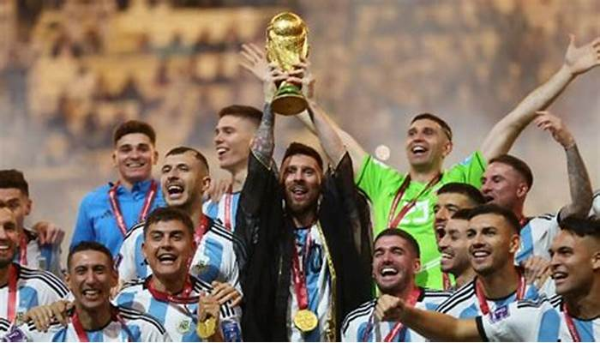
Winners
Argentina's Lionel Messi sits on Sergio 'Kun' Aguero's shoulders as their team celebrates their victory over France in the 2022 World Cup final on Sunday, Dec. 18, at the Lusail Stadium in Lusail City, Qatar. David Ramos/FIFA via Getty Images The 2022 World Cup came to an end Sunday, with Argentina as the victors.
10

Slide 11
Conclusion
The FIFA World Cup Qatar 2022 was always certain to be a tournament like no other.
It was the first time that the most famous competition in global sport was held in the Arab world, that it was played in such a small geographic area, and that fans of all 32 nations could congregate in one space to bond over a shared passion.
It was also the first time that Lionel Messi finally got his hands on the most coveted prize of them all: the FIFA World Cup Trophy.
11

Slide 12
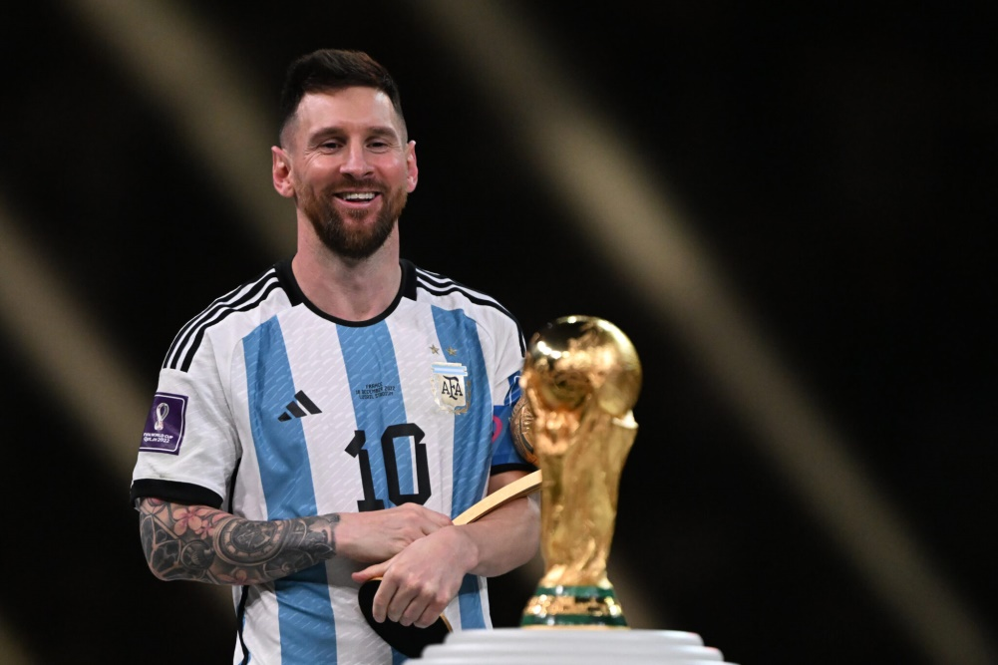

12

